Slide 1
Genesis Cleaning Plan III
July 2012

Slide 2
Table of Contents
Slide
3 Overview
4, 17 Cleaning Methods Table
5 Cleaning Assessment Methods Table
6-7 Particle Mapping
8-9 XPS
10-12 TRXRF
13-14 TOF SIMS
15-16 SIMS
18-20 UPW
21-23 Brown Stain
24 Acid Cleaning
25-26 CO₂ Snow Cleaning
27-30 Giant Cluster Ion Beam
31-32 Acetate Peels

Slide 3
Particulate contamination is the major obstacle to completion of Genesis science objectives.
We need to have clean surfaces to be able to analyze cm-size areas.
Cleaning studies will learn how to clean, using sub cm size samples.
Approach: clean, assess cleanliness, reclean, reassess, etc.
Once we learn how to clean, then “clean” (i.e. to the best of our ability) samples can be stored at JSC for allocation.
All solar wind analytical protocols must have an initial surface cleaning step, but this can only be expected to work with contamination levels 1-10 times the solar wind atoms/cm2. Most samples are way above this at present, thus this cleaning plan is required.

Slide 4
Table 1 Cleaning Methods
PIs
Curatorial Facility
Curatorial Facility
Burnett, Humayun, Jurewicz
Veryovkin
Veryovkin
Kuhlman
Veryovkin
Jurewicz
Burnett, Jurewicz
In use
Ultra Pure Water (UPW)
UV ozone
Wet (acids, hot xylene)
CO₂ snow
Giant Cluster Ion Beam (GCIB)
Acetate peels
Other possibilities
Low energy ion beam
Mechanical
Gas/Ion etching

Slide 5
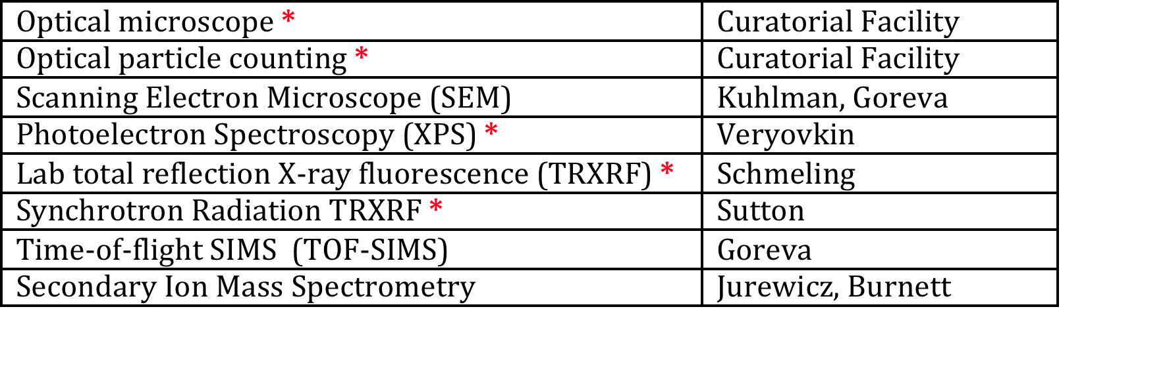
Table 2 Cleaning Assessment Techniques
* Applicable for use on cm-sized “clean” samples
Assessment techniques are discussed on slides 6 - 16

Slide 6
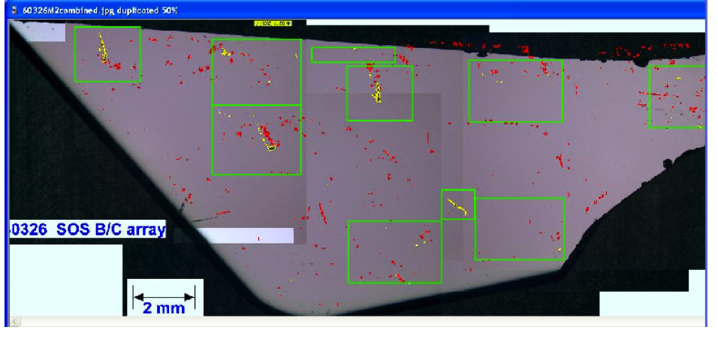
Particle Mapping (Curatorial Facility)
Image is a 226 micron mosaic of large SoS sample 60326. The image processing cannot distinguish pits and particles; many of the features mapped are crash-derived scratches or pits. If necessary, these can be distinguished by optical microscope examination. Color differences can be sensed (red and yellow). In this case the red features are after an HCl etch.

Slide 7
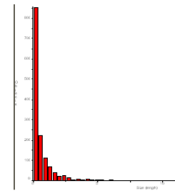
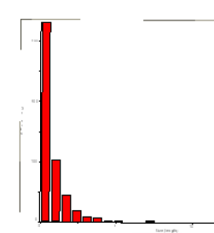
60326 Feature Size Distributions
1200
500
Feature length distributions (linear scales) in two 226x226 micron areas on SoS 60326. The vertical lines indicate 10 microns. As recovered, Genesis samples have large numbers of particles, but most greater than 5 microns in size are removed by UPW megasonic cleaning.

Slide 8
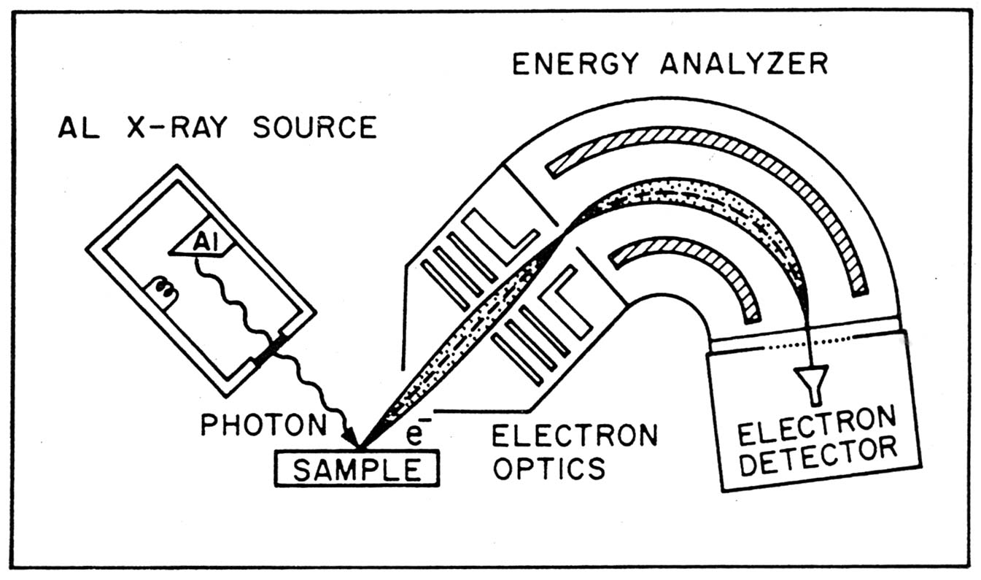
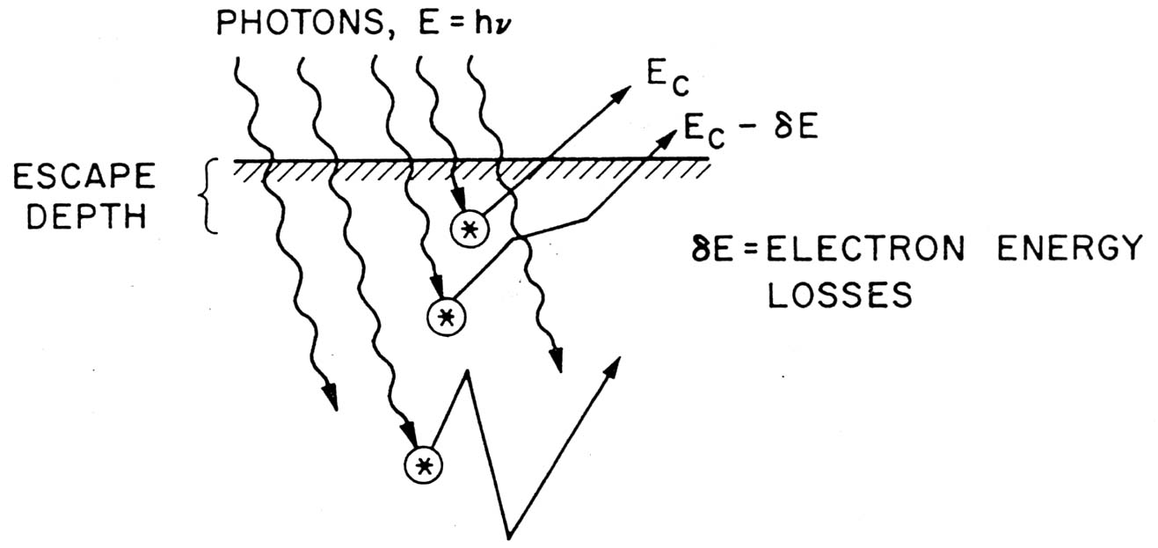
Photoelectron Spectroscopy (XPS)
Monochromatized Al X-rays are stopped in a sample by photoelectric effect interactions, producing a monoenergetic photoelectron, the energy of which identifies the element. The resulting photoelectron spectrum (next page) is a mixture of useful lines and a useless continuum with the continuum representing electrons that scatter before leaving the sample. The lines represent electrons that are emitted without being scattered. The scattering mean free path is roughly 20A, so that only the outer few monolayers are probed by the line spectrum.
Mm sized areas are measured.

Slide 9
XPS spectrum (EAG) of flight Si sample 60111. Both photoelectron and Auger electron lines are identified. The intensity of the C1s line measures the amount of brown stain (see below). The O arises from the Si native oxide layer (15-20 A). The Ge represents powdered collector array material from the crash and is an ubiquitous, but potentially harmless, contaminant.
XPS is relatively insensitive, with detection limits in the 10¹⁴ atoms/cm² range. Because of the short mean free path, XPS is relatively insensitive to particles.

Slide 10
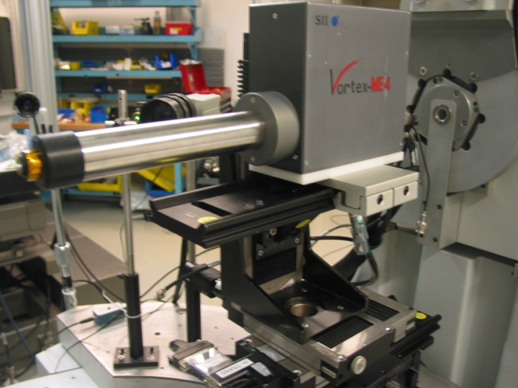
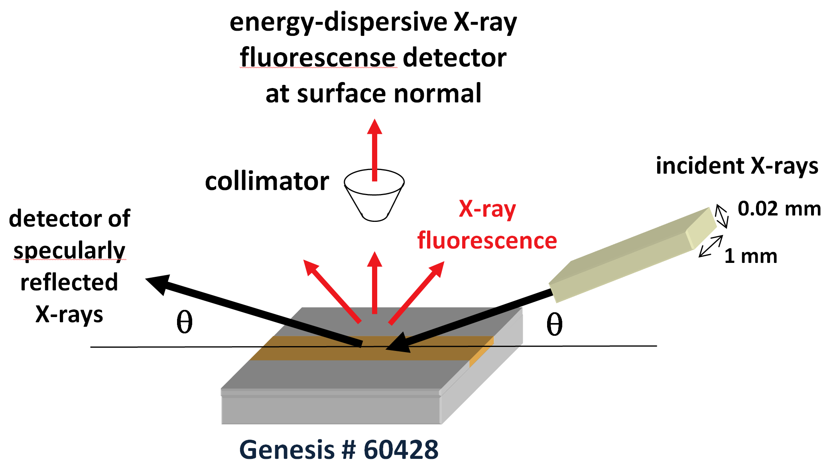
Lab X-ray and Synchrotron Radiation TRXRF (Schmeling, Sutton)
Synchrotron Radiation apparatus
Reflected photons don’t penetrate; otherwise detector would be jammed with Si X-rays; allows preferential fluorescence of surface contaminant particles.

Slide 11
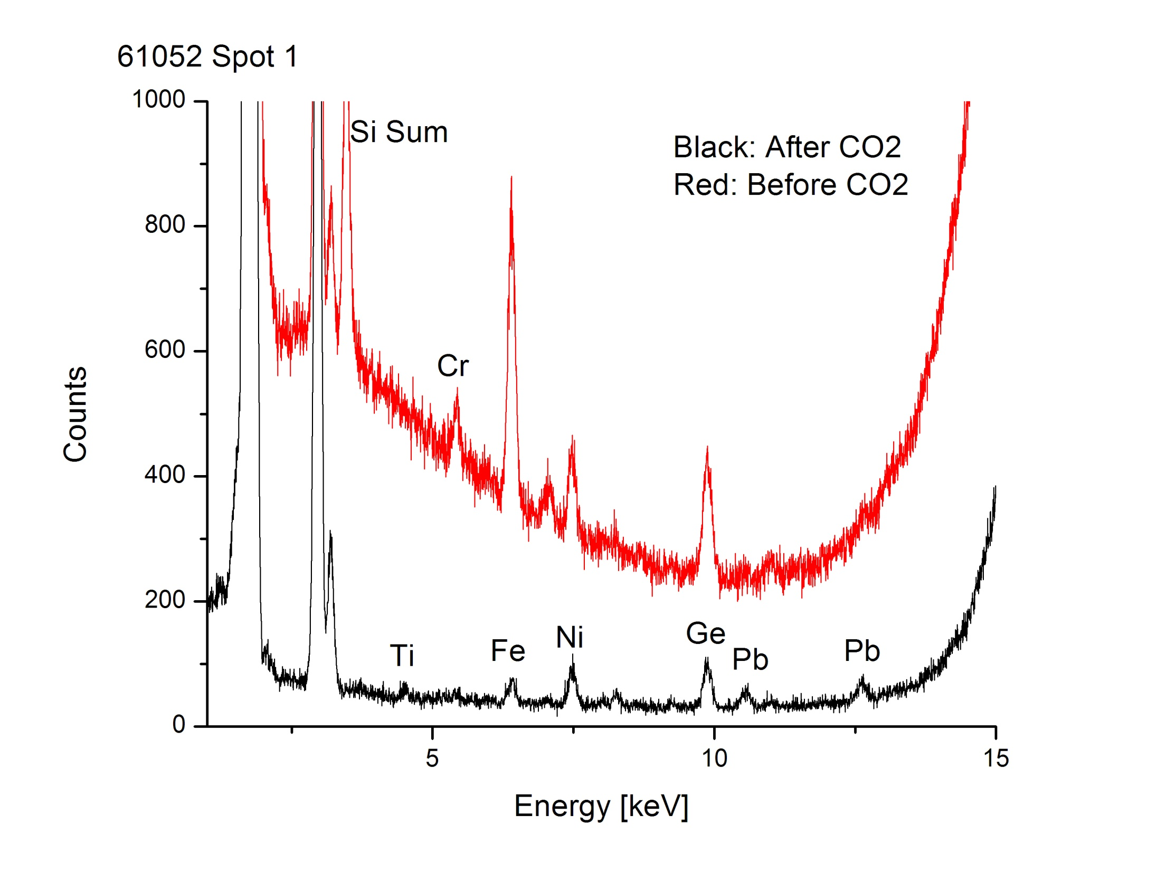
Laboratory TRXRF spectrum of Si sample 61052 (Schmeling)
Scattered Mo L line X-rays limit contaminant X-rays to about 13 KeV (Rb). Low fluorescence yield gives poor sensitivity for elements lighter than Ca. K X-ray lines from Ca-Rb; L lines from Hf through Pb measurable.
High background in before spectrum interpreted as inelastic scattering from organic contamination. Contaminants significantly, but not totally, removed by CO₂ snow cleaning, discussed below.
Detection limits in 4-13 keV range about 10¹¹ – 10¹² atoms/cm². Area analyzed about 1x5 mm.

Slide 12
Synchrotron radiation TRXRF spectra at critical angle (preferentially fluorescing contamination). SoS 60326 shows much less Cr, Mn, Fe, Ni, Cu, Zn than SoS 60966. Reflected photon energy can be varied. Detection limits 10⁹ – 10¹¹ atoms/cm², depending on element and photon energy. Areas analyzed roughly 1x5 mm

Slide 13
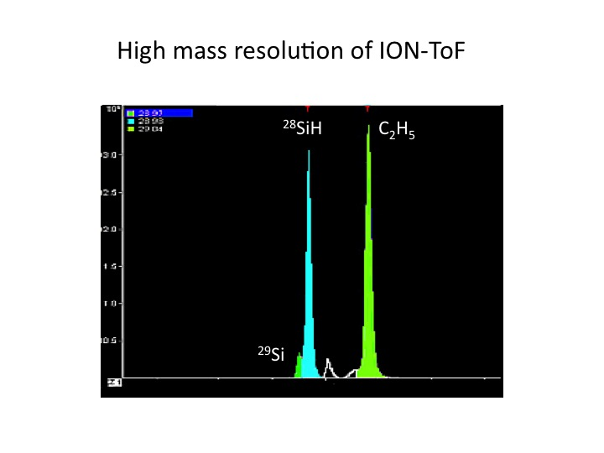
Time-of-Flight SIMS (Goreva)
Samples are sputtered with a pulsed ion beam and secondary ions measured with a time-of-flight mass spectrometer, capable of operating at high mass resolution to distinguish interfering molecular ion peaks. Example shown for mass 29. Sputtering rates are very low with pulsed beam, so only surfaces are analyzed.

Slide 14
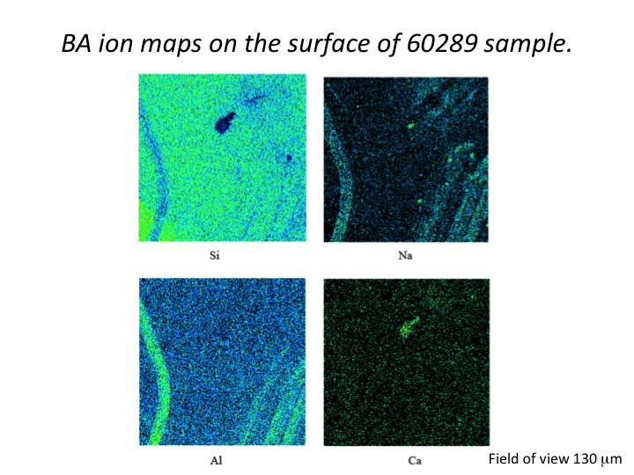
60289 Si has a clean lab TRXRF spectrum, but large Ca and Cr backgrounds, interfering with SIMS analysis (slide 16).
This image shows correlated Al, Na streaks (scratches). Other images show Fe, Na rich scratches.
60289 was recognized as a heavily scratched sample but had apparently clean areas for SIMS analysis.

Slide 15
Conventional (Cameca) SIMS
There are serious disadvantages to the use of conventional SIMS analysis to assess cleaning:
Small areas analyzed (order 100 microns)
Not quantitative for surface analysis due to transient sputtering.
Long turnaround time for assessment.
However, conventional SIMS can provide an (ultimate?) check of a sample that appears to be clean by other assessment techniques. For elements like NaAlCaCr on precleaned samples, there are essentially no clean spots so sampling is not as issue.
Cleanliness is verified by obtaining a clean, uncontaminated solar wind profile of the above elements, as illustrated by the solar wind modeling curve in the following figure.

Slide 16
SIMS Ca profile on Si sample 60289
Sample had only standard JSC UPW cleaning. A cleaned sample showing a profile like the theoretical solar wind profile can probably be considered “verified” clean

Slide 17
Cleaning Methods
PIs
Curatorial Facility
Curatorial Facility
Burnett, Humayun, Jurewicz
Veryovkin
Veryovkin
Kuhlman
Veryovkin
Jurewicz
Burnett, Jurewicz
In use
Ultra Pure Water (UPW)
UV ozone
Wet (acids, hot xylene)
CO₂ snow
Giant Cluster Ion Beam (GCIB)
Acetate peels
Other possibilities
Low energy ion beam
Mechanical
Gas/Ion etching

Slide 18
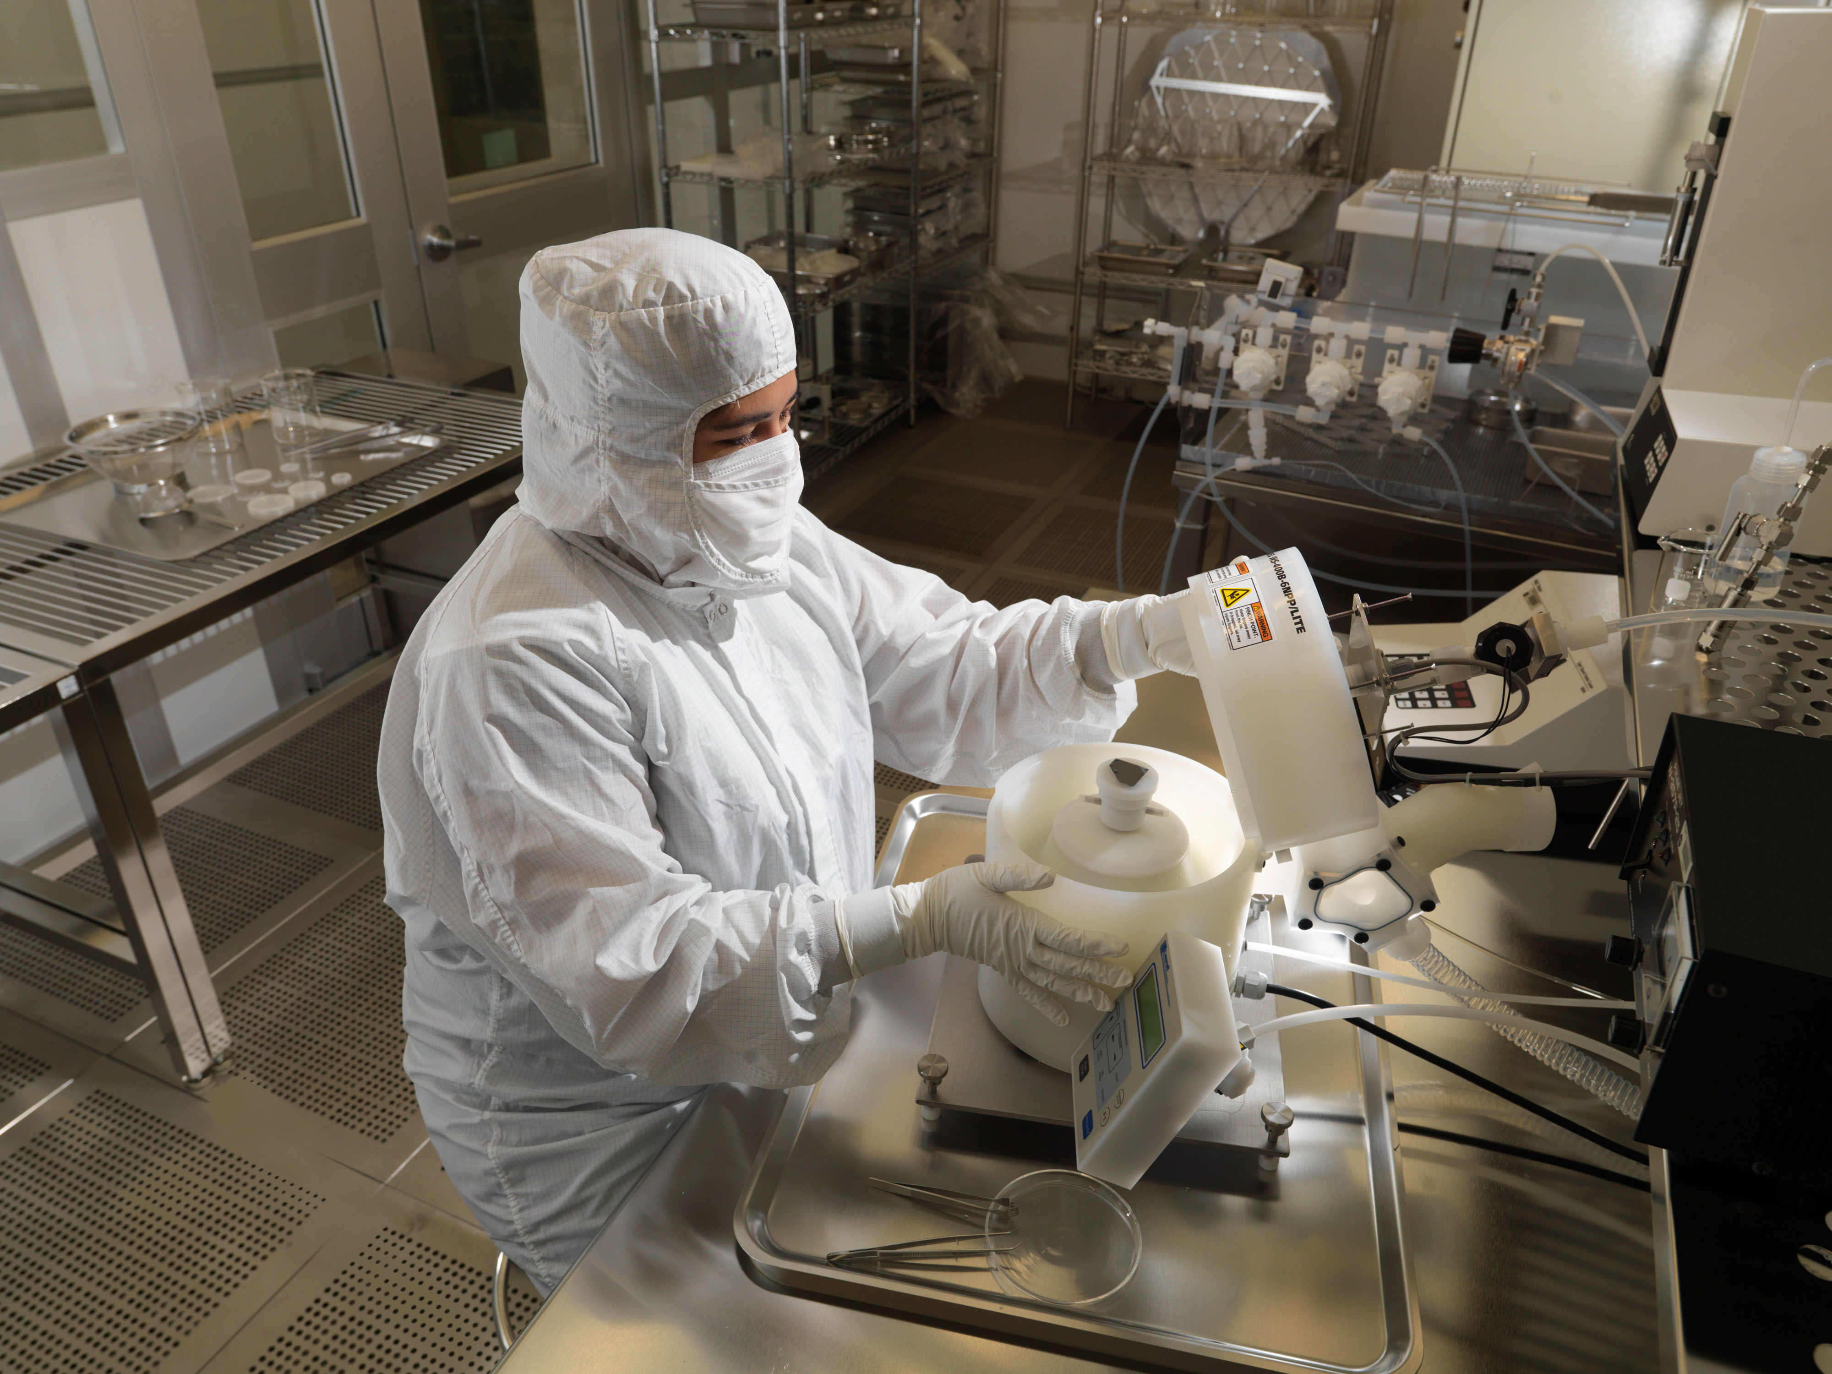
Ultrapure water (UPW) Megasonic Cleaning (Curatorial Facility)

Slide 19
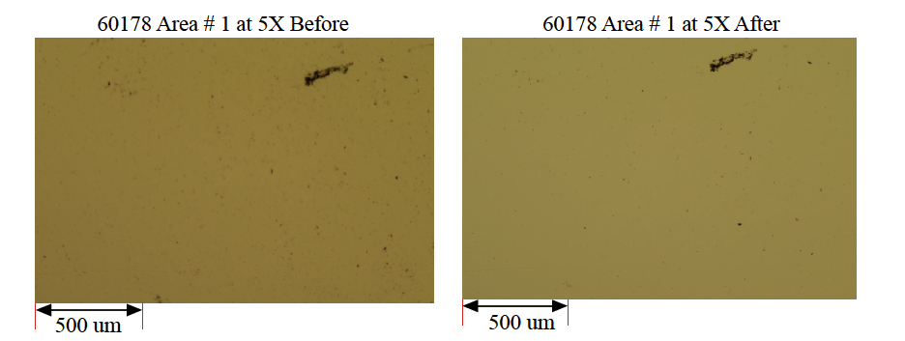
UPW cleaning of Si 60178 (Allton et al; LPSC 2007)
This is a low mag image, but most of the small dots in the before image are particles greater than 1 micron in size that are absent in the after image, being removed by the UPW. The large dark feature in the upper right is a crash-derived scratch. Surviving larger dark features in the after image are probably also pits or welded on pieces of Si.

Slide 20
Before
Enhanced contrast image of a magnified area on 60178 (previous slide) before and after UPW cleaning. The scratch on the lower left of both the before and after images is about 50 microns.
After

Slide 21
Brown Stain
Brown stain is a flight-derived polymerized silicone film, 0-60 A thick.
It did not interfere with solar wind implantation, but it potentially interferes with many analyses and must be removed.
Although resistant to organic solvents and oxidizing acids, uv-ozone treatment effectively removes brown stain.

Slide 22
Uv Ozone Removal of Brown Stain
Before (blue)-after (red) XPS C and Si counting rates on same flight sample. Decrease in C by uv ozone gives higher counting rate from underlying Si. JSC Vendor tests (Diamonds); JSC instrument (triangle); Open U facility (dots). Scatter in before data reflects variability in brown stain. XPS instrument has relatively low, but unmeasurable, C background

Slide 23
nanoSIMS image of uv-ozone cleaned flight Si (Guan)
JSC uv ozone treatment. C and Si maps show approx. 0.4 micron C-rich dots which attenuate underlying Si signal. These are undoubtedly uv-ozone-resistant residual patches from a uniform brown stain layer. This indicates about 90% removal which is probably acceptable for most purposes.

Slide 24
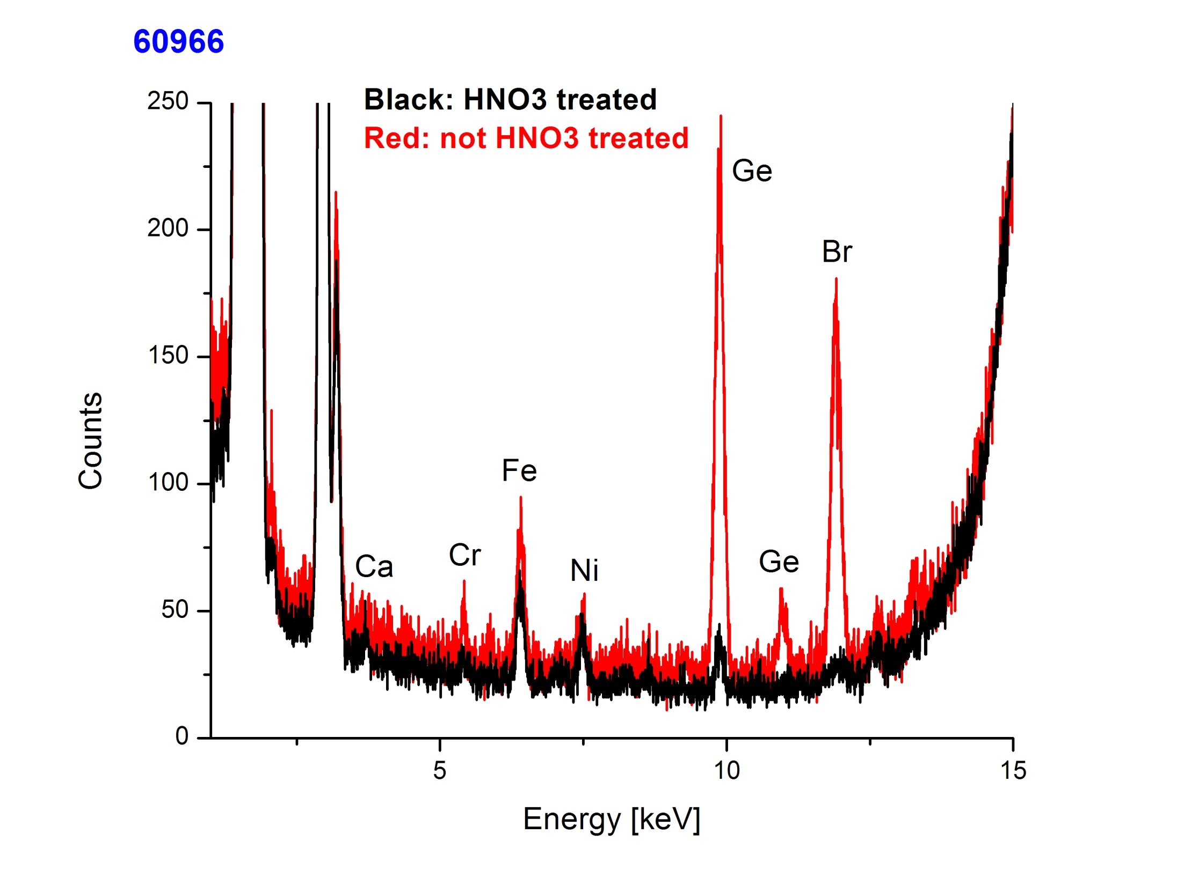
SoS 60966; example of acid cleaning.
Lab TRXRF spectrum before (red) and after (black) HNO3 treatment. Br peak from a previous HCl treatment removed by HNO₃. The acid significantly reduces, but does not remove, Ge and Cr contamination. The Fe and Ni (stainless steel) are only slightly affected.

Slide 25
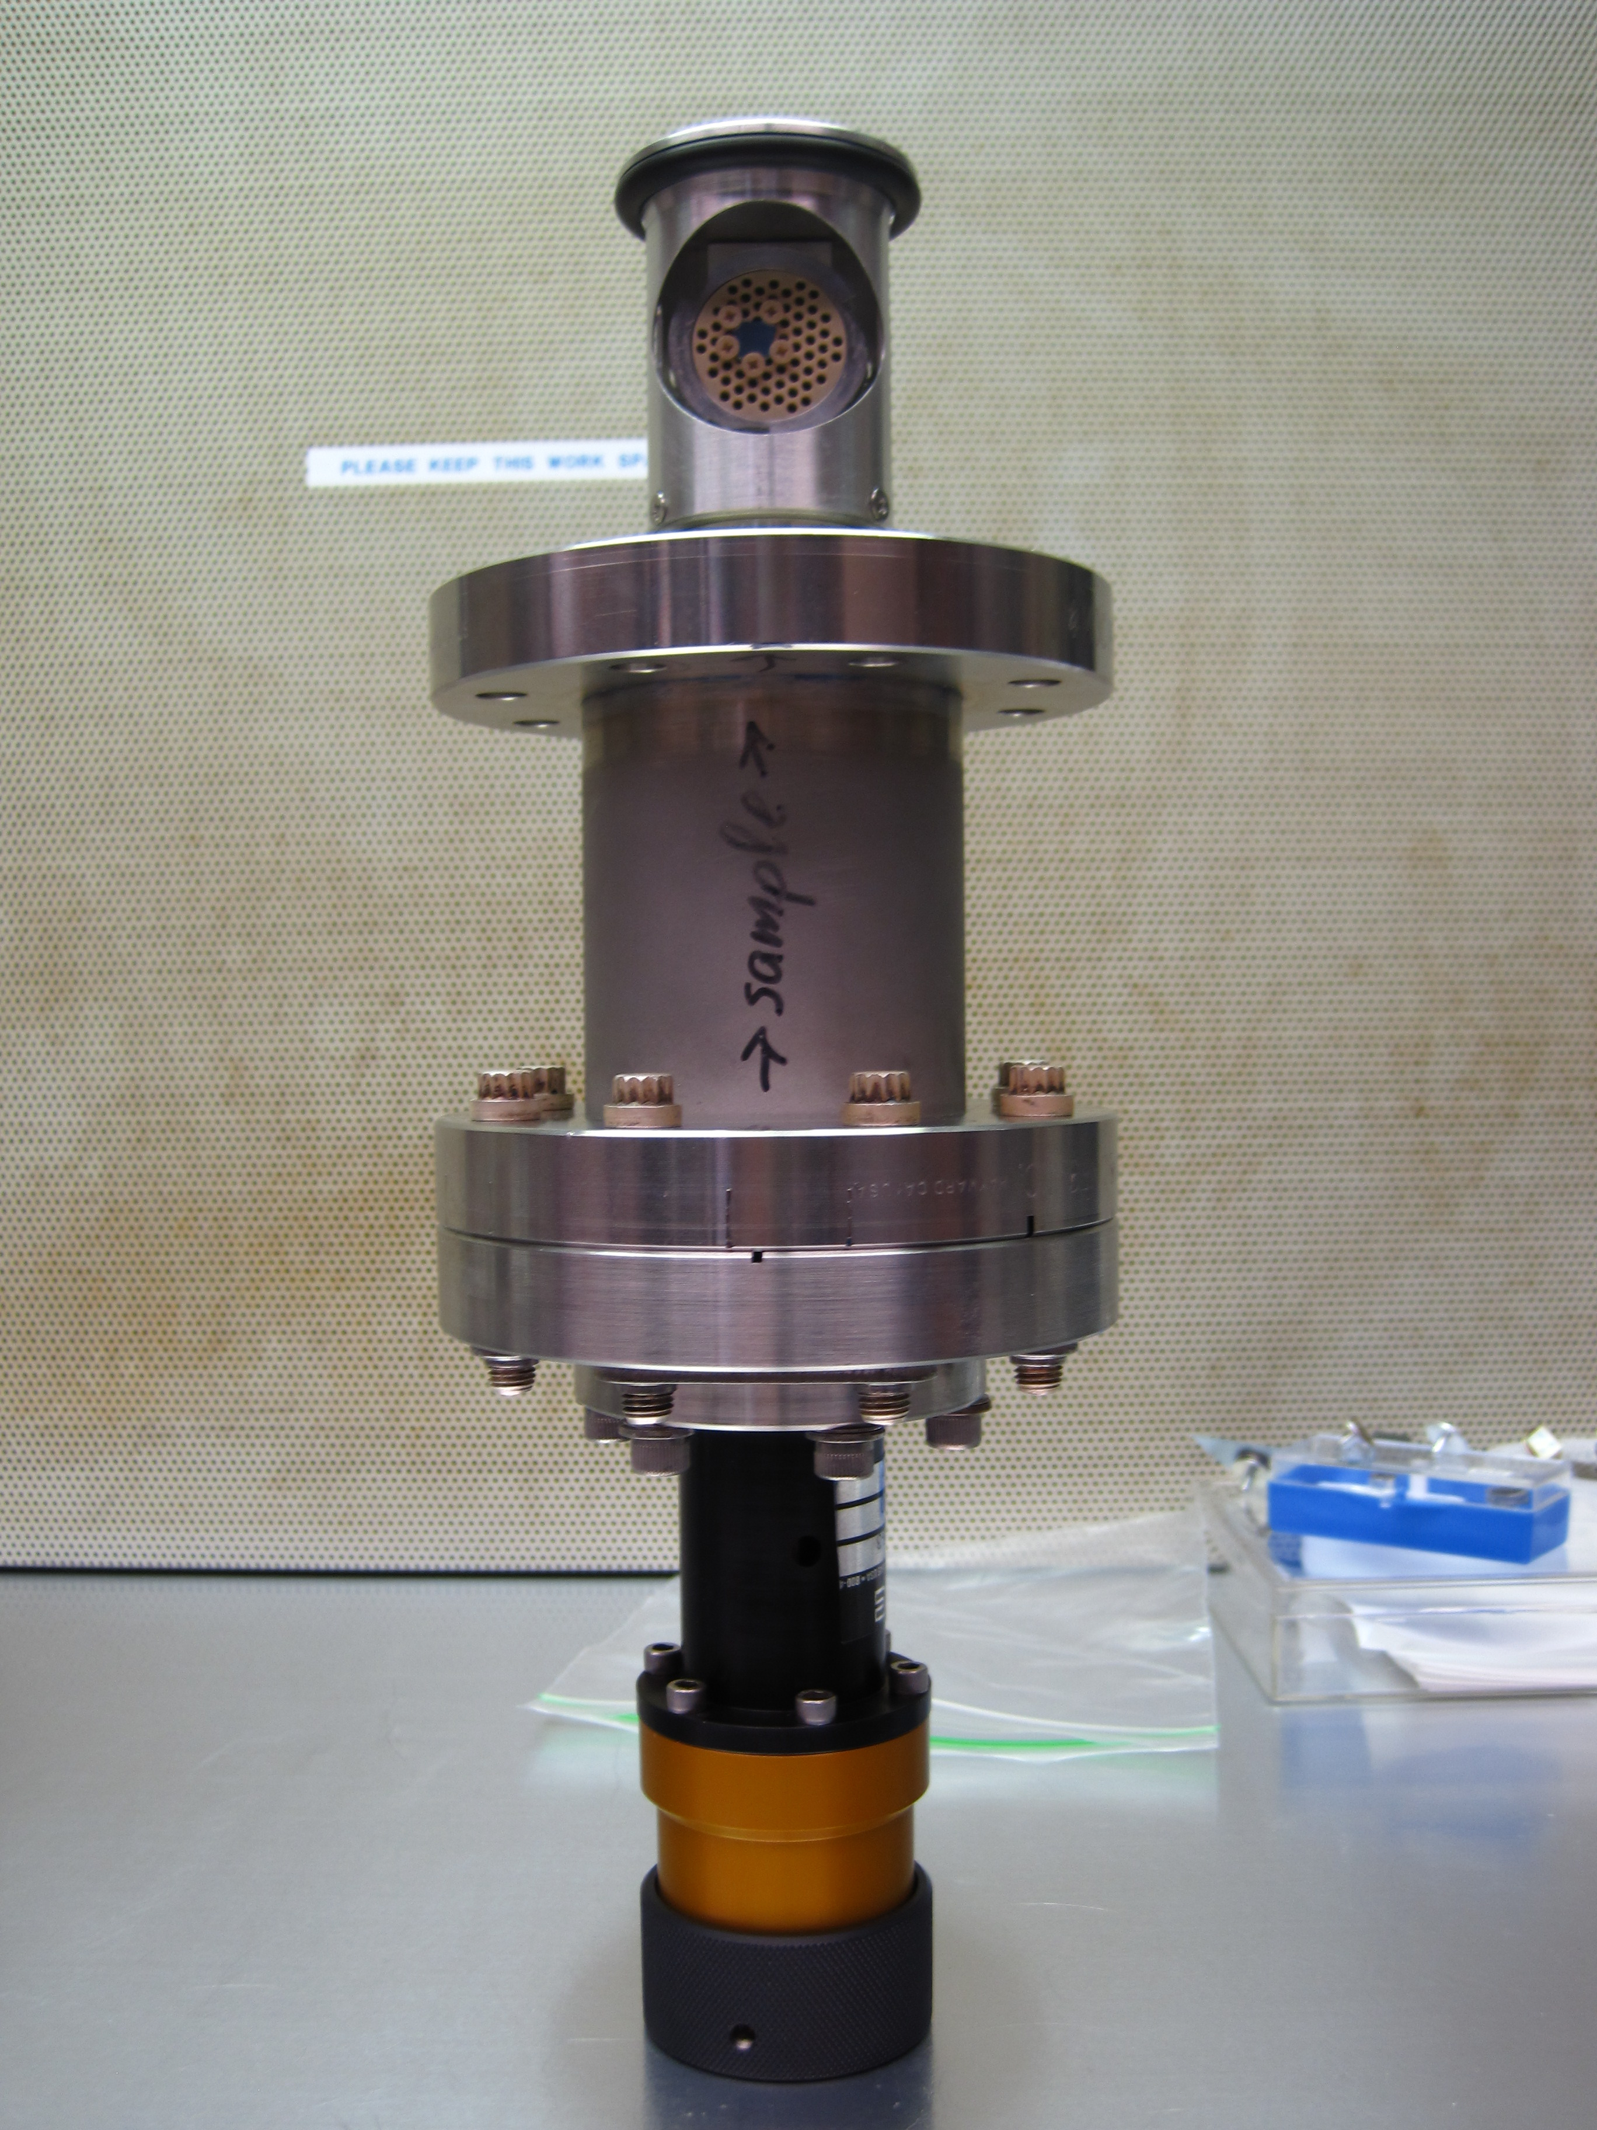
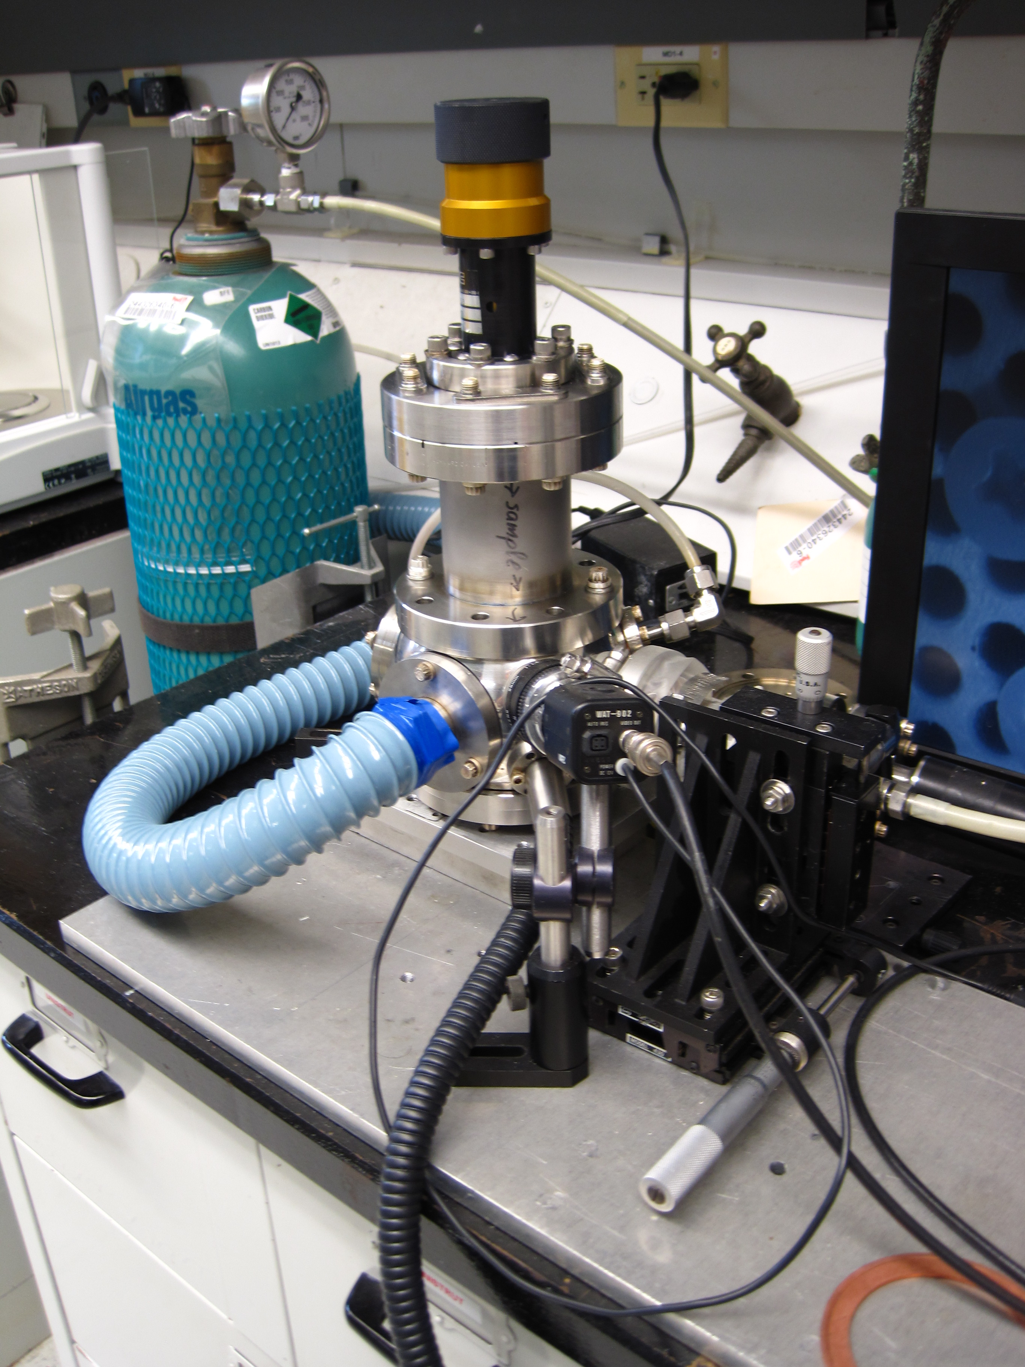
CO2 Snow Cleaning (Tripa, Veryovkin)
61052
Condensation and evaporation of CO₂ from surfaces removes particles. ANL installation shown on right. Si sample 61052 shown, as mounted on PEEK (C nanotube) plate which is installed in a vacuum transport container in a laminer flow bench.

Slide 26
Laboratory TRXRF Si 61052 before and after CO2 cleaning
High background interpreted as scattered X-rays from organic contamination. This and elemental contaminants significantly, but not totally, removed by CO₂ snow cleaning.
Pb peaks in after spectum may indicate that before and after spots not exactly same or may come from CO2 snow.
Systematic testing in progress.

Slide 27
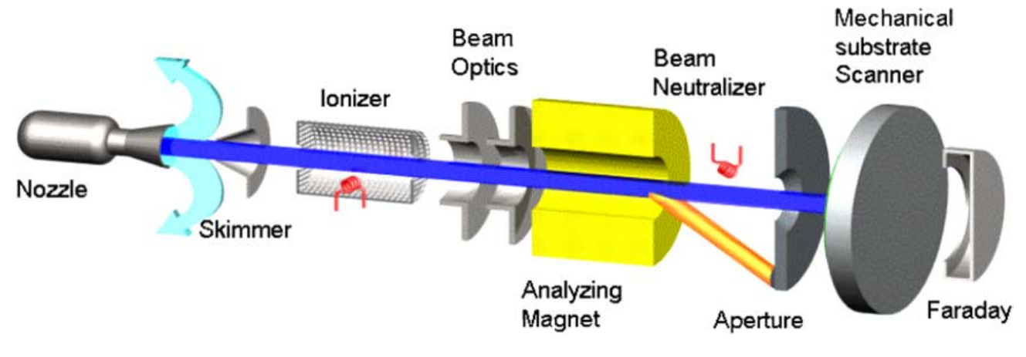
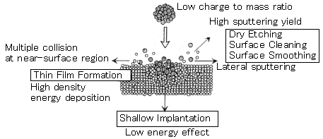

Giant Cluster Ion Beam (GCIB)
20 keV Ar₂₀₀₀⁺ ÷ Ar₃₀₀₀⁺ ions. Very low velocity ions sputter cleans surface without downward mixing of contaminants

Slide 28
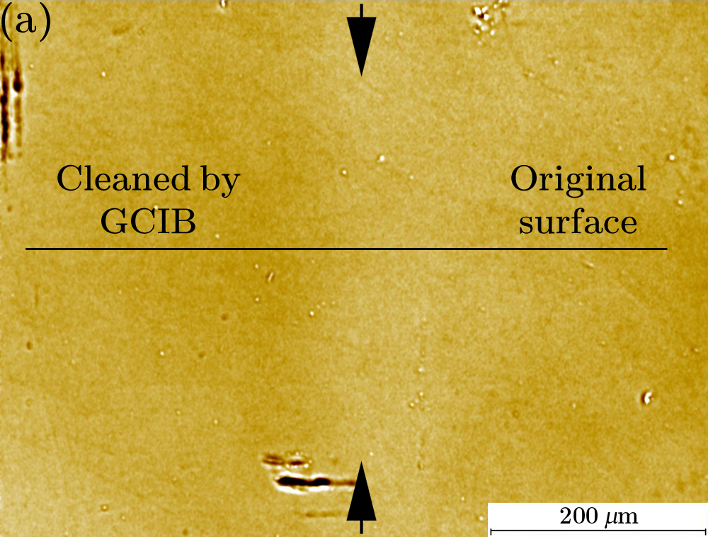
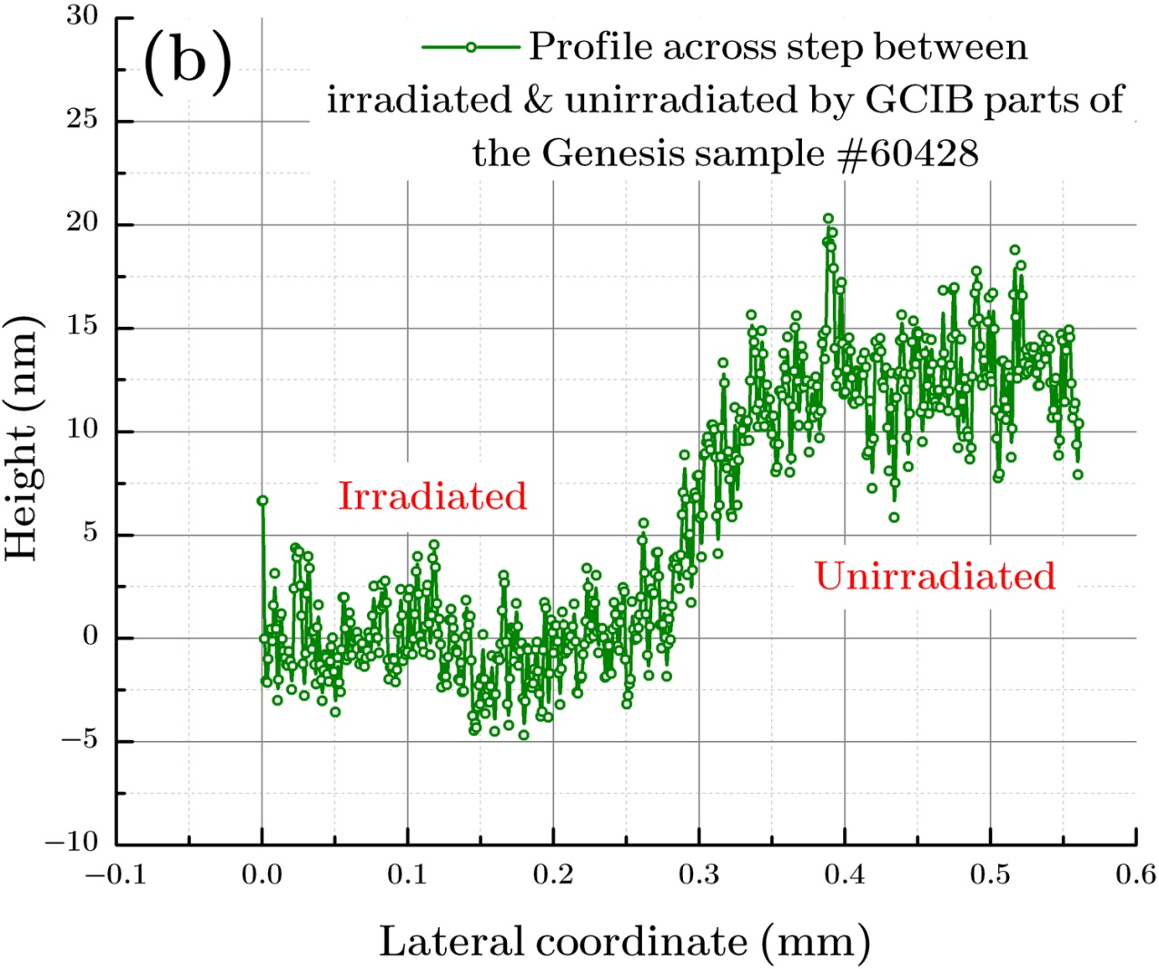
White Light Interferometry of amount of GCIB erosion.
Approximately 12.5 nm of Si sample 60428 was removed by GCIB. This is a bit too much, but it should be possible to control erosion of 8 – 12 nm for which loss of solar wind is small.

Slide 29
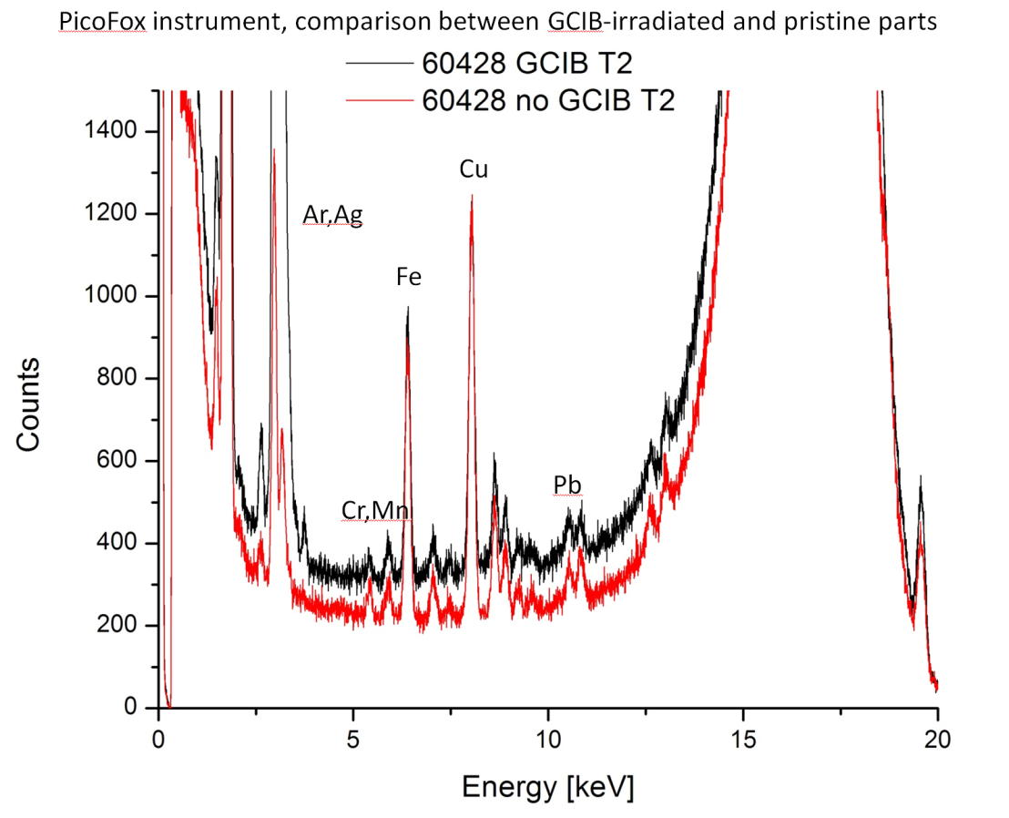
GCIB Si 60428
LAB TXRF comparison of irradiated and non-irradiated spot. Significant reduction of Fe and Cu in this comparison

Slide 30
Synchrotron TRXRF 60428
GCIB-irradiated areas, blue and red; unirradiated area black. Here higher amounts of contaminants in GCIB-irradiated areas! Analyses refer to roughly 1x5 mm stripes. Large amount of contaminants remain, but this appears to be a very dirty sample. Difference may reflect inhomogeneities and/or particles may be larger than 10 nm in this case. More systematic tests where same area is compared before and after GCIB are required.

Slide 31
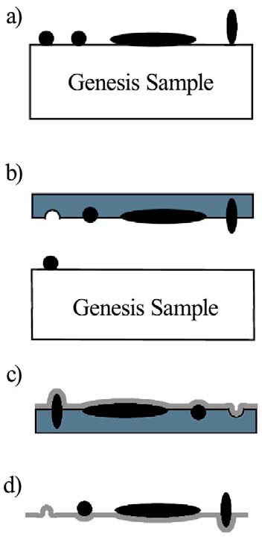
Acetate Peels (Kuhlman)
Schematic illustration of the typical method of using carbon extraction replicas. a) dirty Genesis sample, b) cellulose acetate solution dried on sample, then replica film peeled from sample. Residual particles can be characterized in SEM
c) replica coated with 60 nm of carbon, d) replica with cellulose acetate film dissolved away. Particles remain trapped in C film and can be characterized in SEM.
Some Genesis materials (Al films on sapphire (AloS); concentrator target materials?) cannot be acid cleaned. Acetate peels are possible cleaning method. SEM studies on peels allow assessment of sapphire based collectors which are too insulating for ion or electron beams.
Systematic tests of efficiency of particle removal are planned.

Slide 32
Application of acetate peels to refractory SoS sample 60966
This sample has been cleaned with HCl (twice), CO₂ snow, and HNO₃ (slide 24 above).
Cleaning has only partly removed the contamination as assessed by laboratory and synchrotron TRXRF. This sample was contaminated with stainless steel in a JPL CO₂ cleaning apparatus, but this should have been easily removed with acid cleaning.
Acetate peeling will be used as a cleaning technique, then the sample reanalyzed by lab TRXRF. If changes are observed in the lab TRXRF spectrum, the particles in the peel will be studied by SEM to guide additional chemical cleaning. If no changes in the lab TRXRF spectrum are observed, SEM characterization of the residual particles will be made, using an environmental SEM if necessary because of charging.
The sample will be cleaned in hot xylene after the peel. The effectiveness of the hot xylene will be assessed with before/after peeling XPS spectra prior to lab TRXRF analysis.

